Slide 1
Percentage of a number
Year 7

Slide 2
Learning Intentions
Students will be able to
To find the percentage of a number successfully

Slide 3

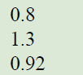
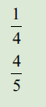
From last lesson
Decimals to percentages
Fractions to percentages
WICOR

Slide 4
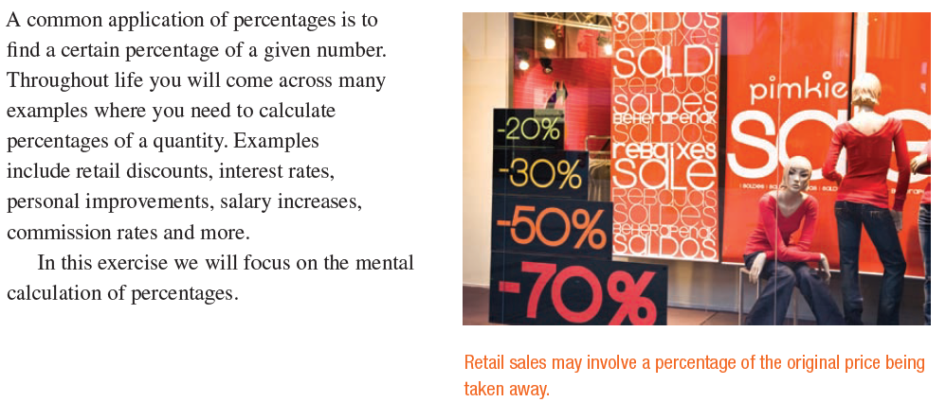
24
7
30
Topic: Percentages
Date:
EQ – How do we find a percentage of a number?

Slide 5
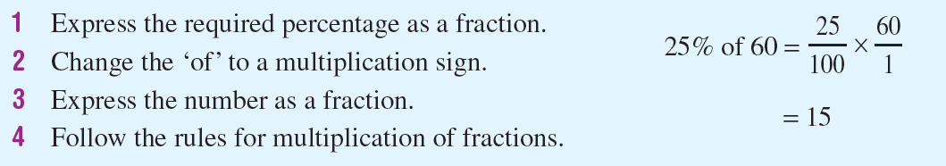

24
7
30
Topic: Percentages
Date:
EQ – How do we find a percentage of a number?
How to find a percentage of a number

Slide 6


Slide 7
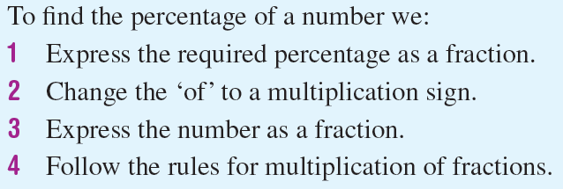
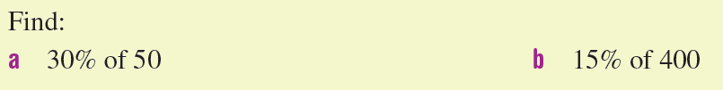
Practice
Notes:
Guide students through the question.
Option 2: Dot plots handout (Scaffolded for kids who may need extra help)

Slide 8
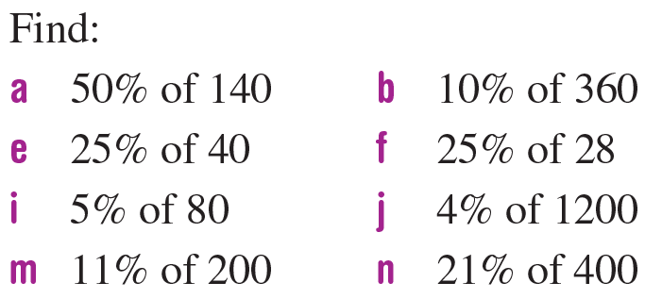
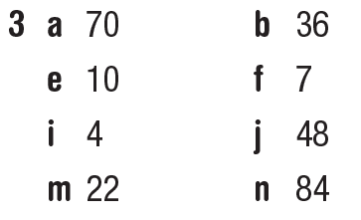
Task
Notes:
Guide students through the question.
Option 2: Dot plots handout (Scaffolded for kids who may need extra help)

Slide 9
Exit pass
Steps to Leave the Classroom
Complete the Mystery Amount Activity
Fill in your summery
Show your teacher these two steps before you may pack up
WICOR
Notes:
Guide students through the question.
Option 2: Dot plots handout (Scaffolded for kids who may need extra help)

